Slide 1
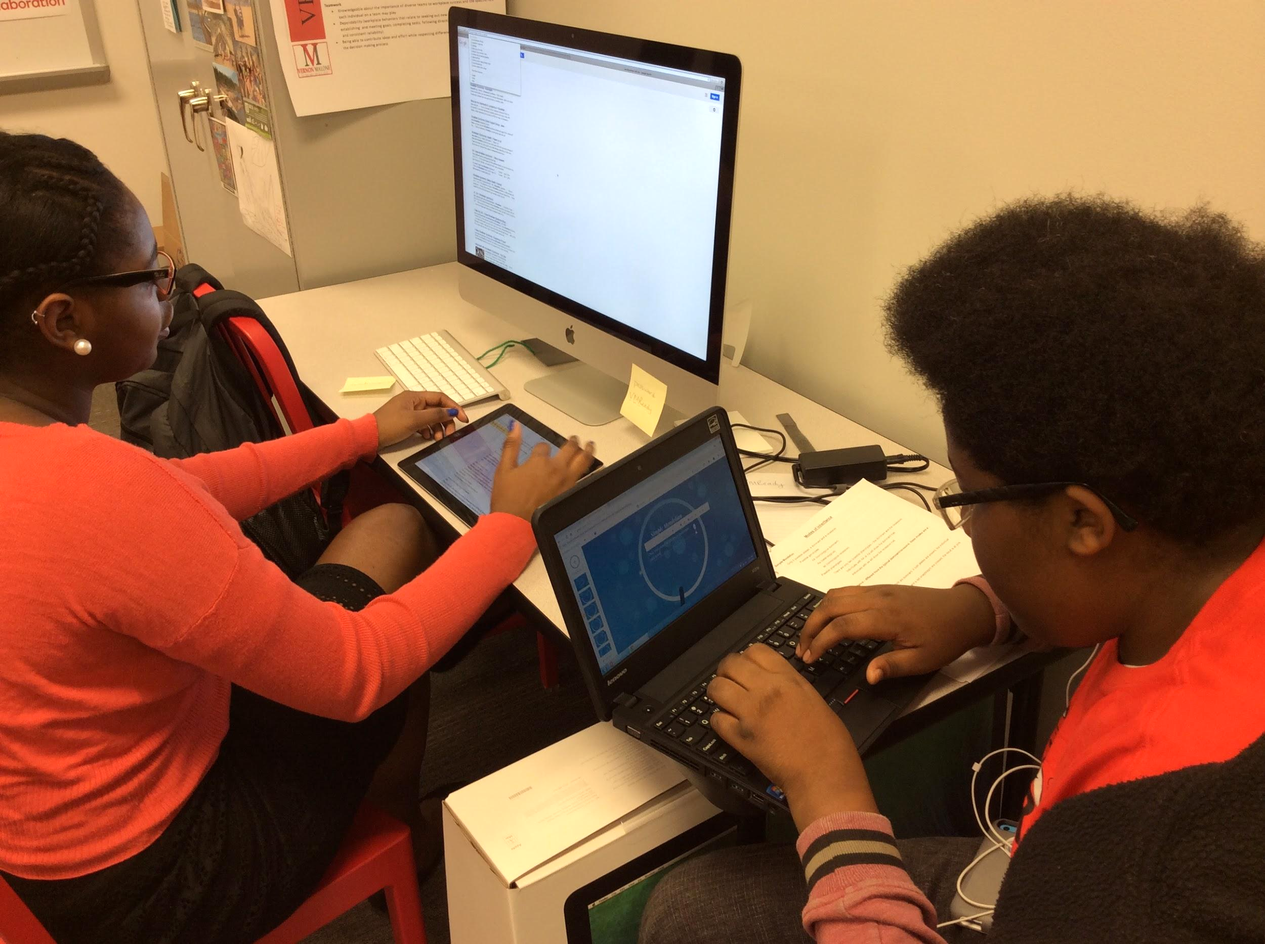
BYOD at VMCCA

Slide 2
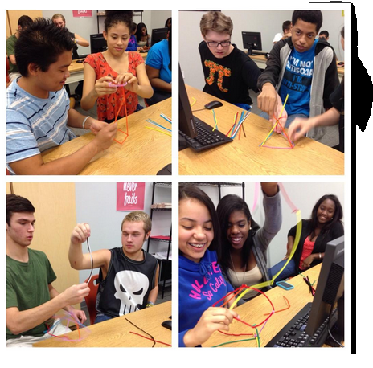
Overview
Overview of BYOD at VMCCA
Objectives:
How is BYOD different than what we’re currently doing?
How will my access to the wifi change?
What is the Responsible Use Agreement?
What are the color zones?
What are the BYOD rules?
How do I keep my device safe?
Notes:
Show the video first, then run through the objectives

Slide 3
How is this different ?
How is BYOD part of the vision for VMCCA?
Watch the video and listen for 3 reasons why BYOD plays a part in the vision of our school.
Notes:
.

Slide 4
Answers
#1 We are preparing you for college & career.
#2 We want our work to reflect the work place.
#3 We want you to be producers of knowledge not just users.

Slide 5
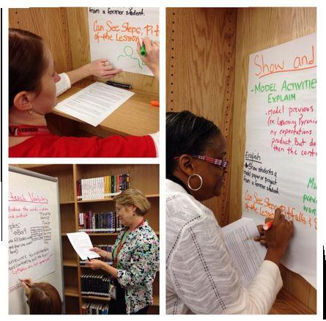
Be Kind
Teaching using BYOD is an adjustment for teachers too.
Notes:
Same way teachers have to learn using technology students have to learn how to learn with technology.

Slide 6
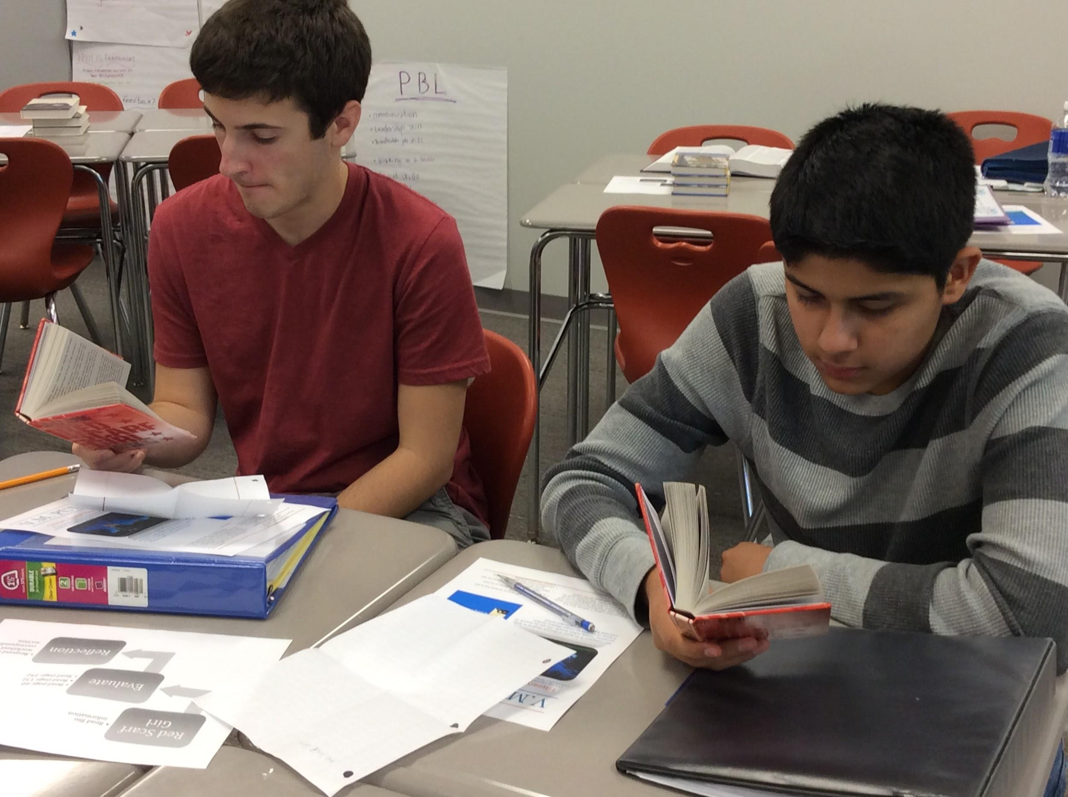
Specific Log-in
Step-by-Step
Wi-Fi Settings
Log in to a “new network”
You’ll be given the network name by the teacher
No password
Read & acknowledge that you agree to the terms of use for the WCPSS BYOD network
Notes:
Students will no longer sign on using Lundenburg. They will use this new log in. Pair students up and have them try the new log-in procedures.

Slide 7


Stop Light Zones
Teachers will use this system to indicate if devices will be in use for each class session.
Notes:
We’ve been very leanient about texting. Now with these stop light rules texting will no longer be allowed in classes unless used for instructional purposes. Administration rules will apply if caught texting. Remember that texting is allowed in the Atrium and Commons Area.

Slide 8
Stop Light Zones
RED Zone
Put away all devices!
Notes:
Texting;

Slide 9
Stop Light Zones
Yellow Zone:
When in yellow seek the teacher’s permission to use your device.

Slide 10
Stop Light Zones
Green Zone:
You may use your device for instructional purposes.
GREEN Zones:
Cafeteria & Commons Area

Slide 11
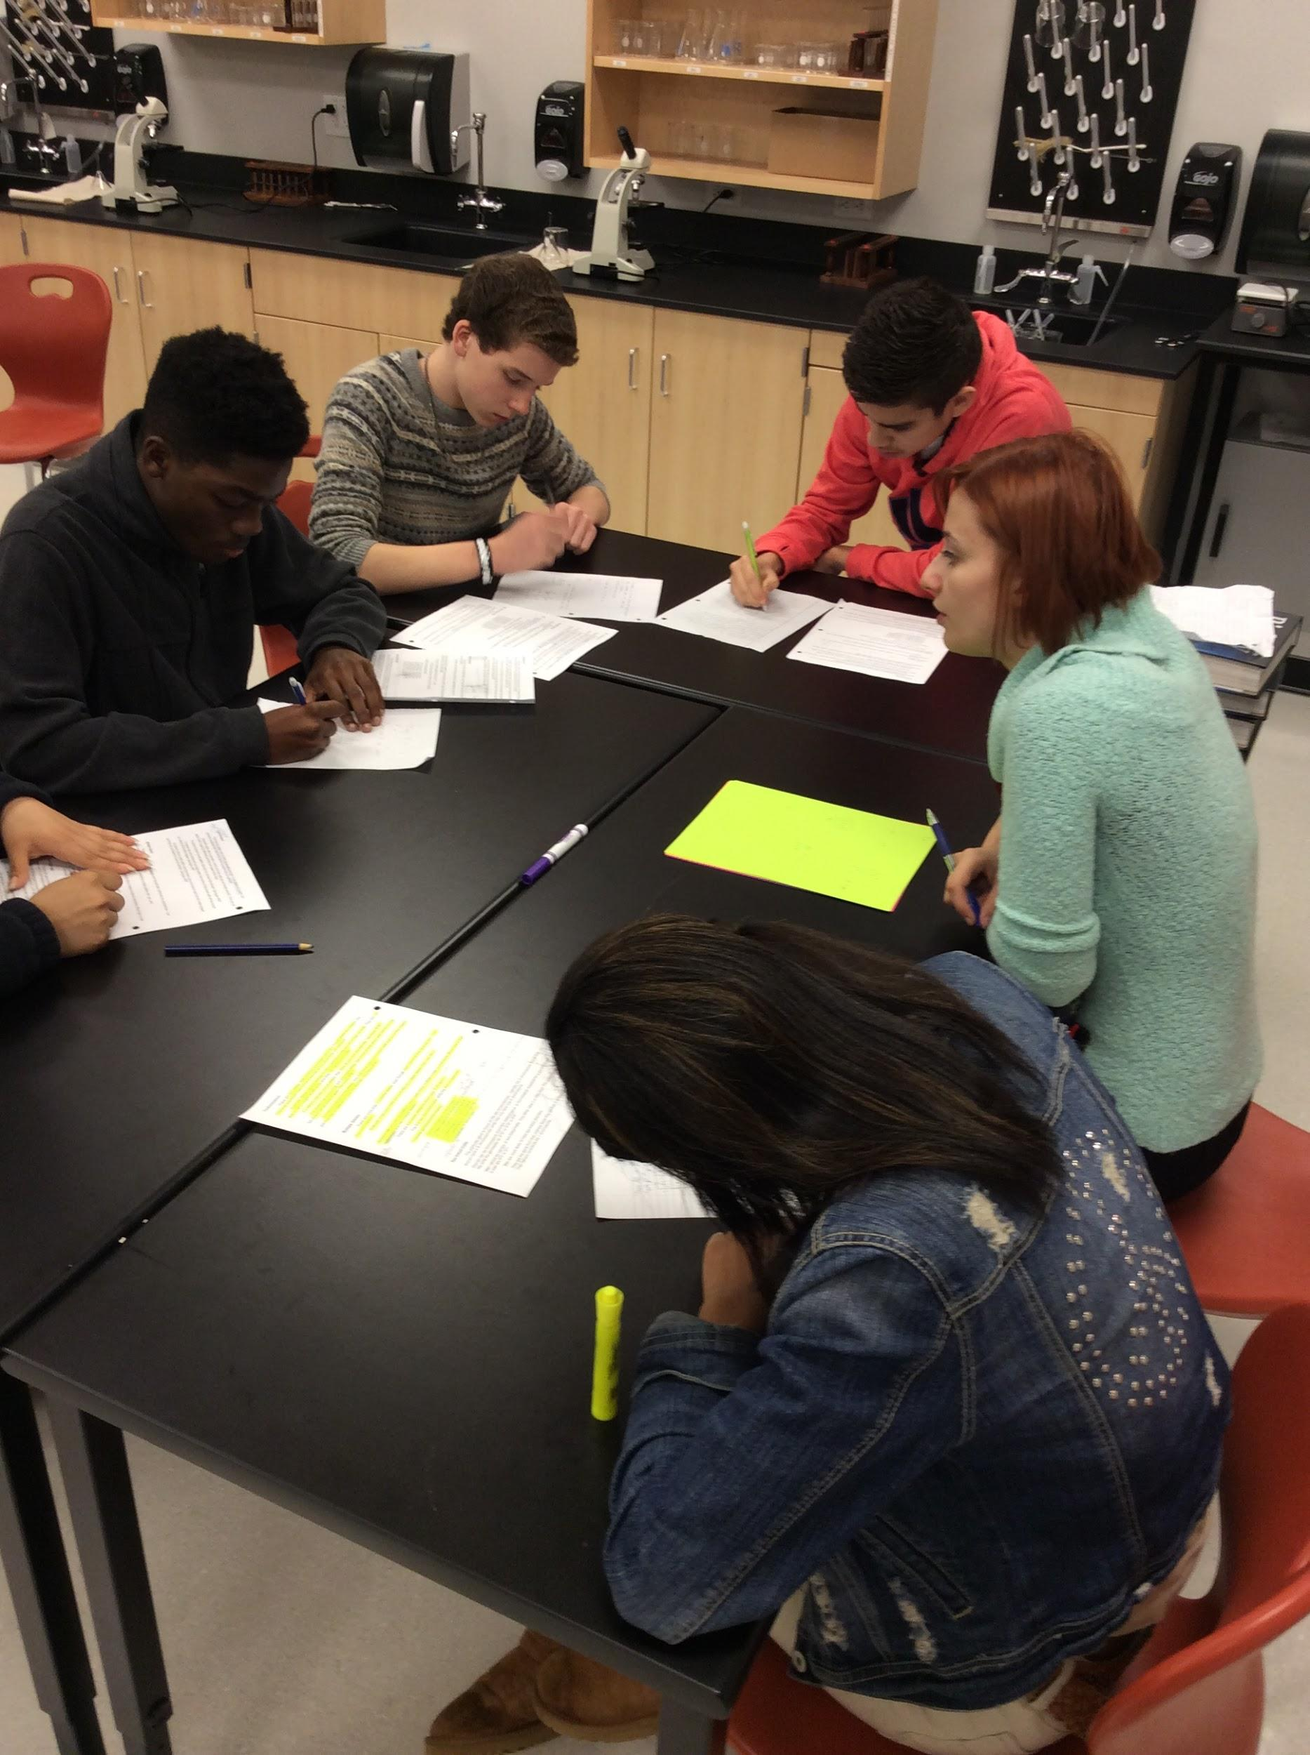
Classroom Rules
Do Not touch other personal devices.
Device must be shown at all times.

Slide 12
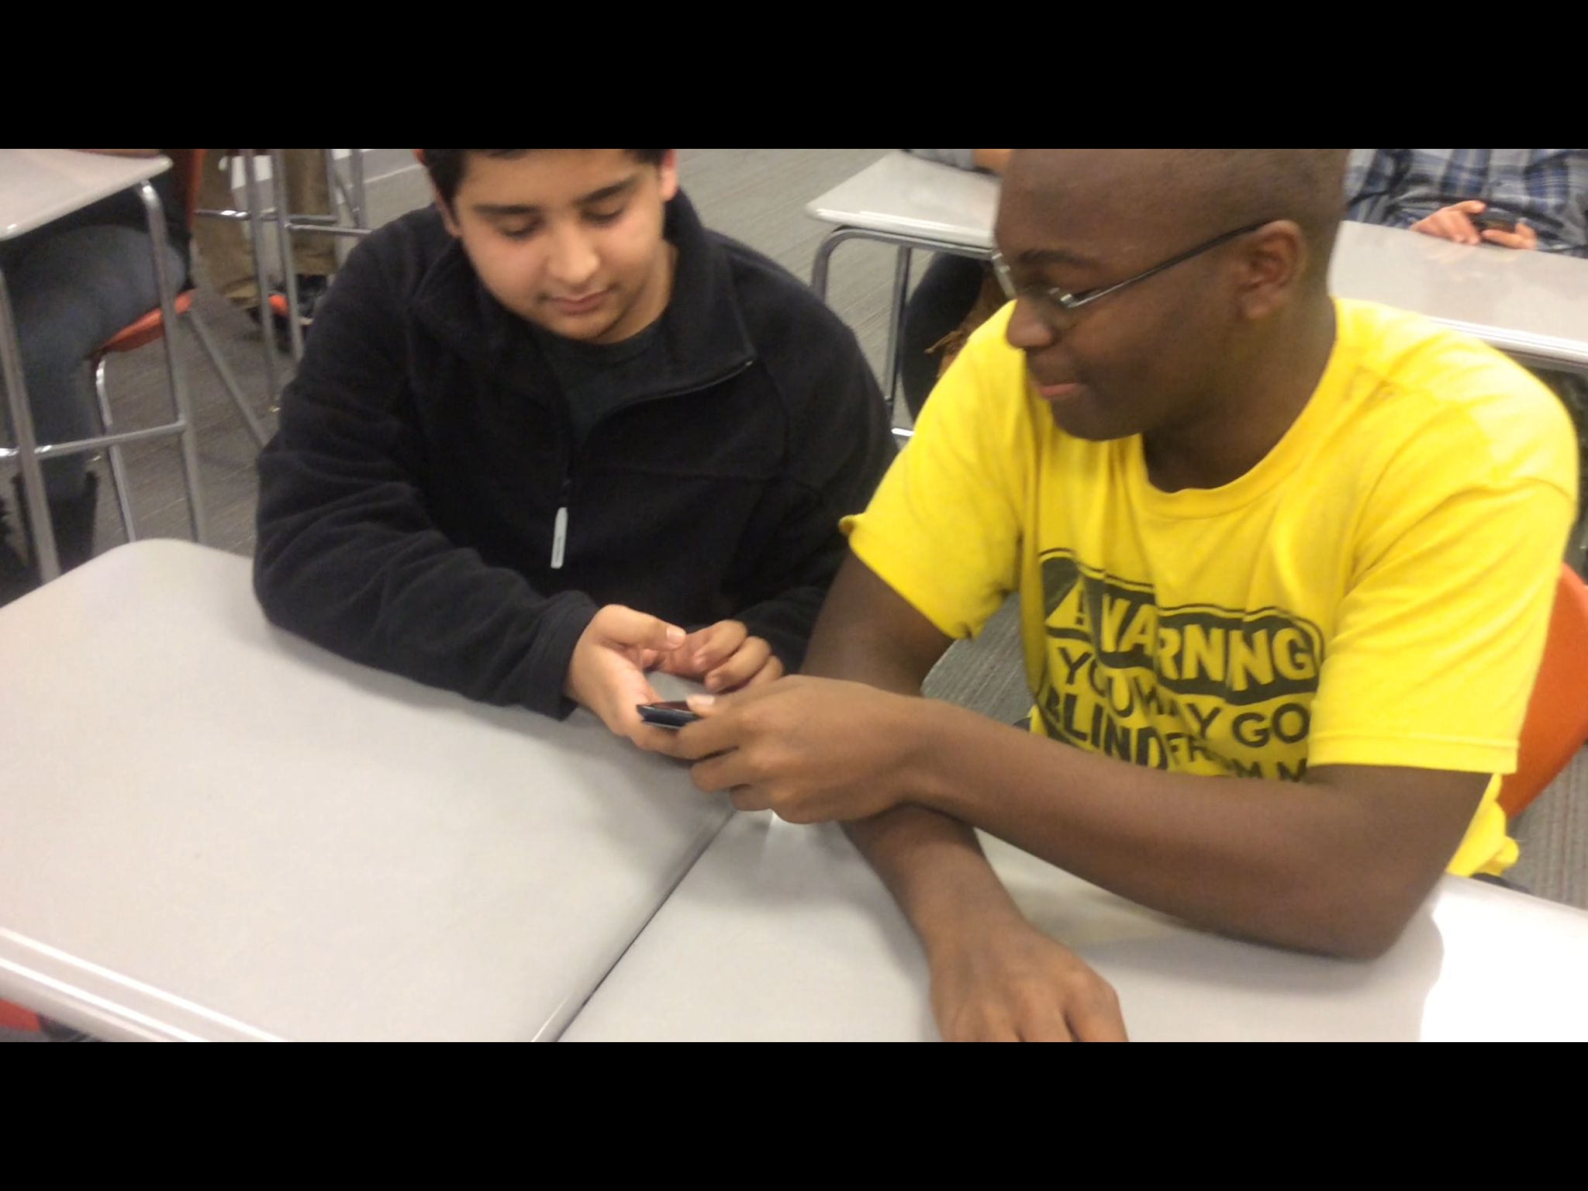
Security
VMCCA staff is not responsible for your device.
Don’t let others use your device.
Consider buying insurance for your device

Slide 13
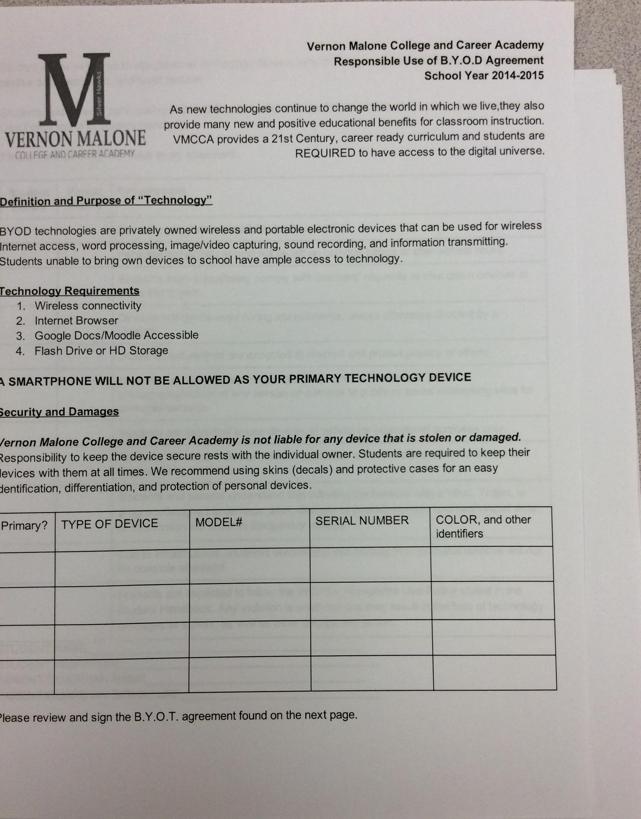
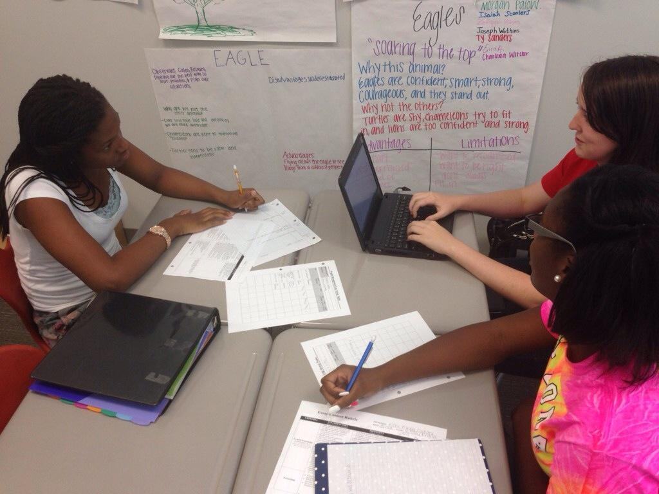
Responsible Use Agreement
This is required before you can participate in BYOD
You must register your device(s)
It must be signed by parent AND student

Slide 14
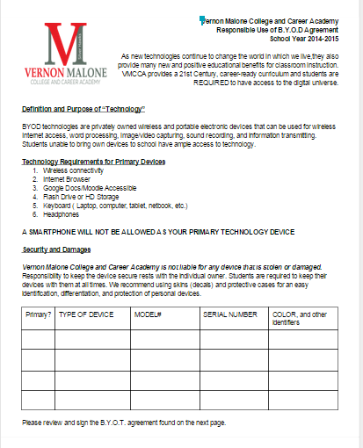
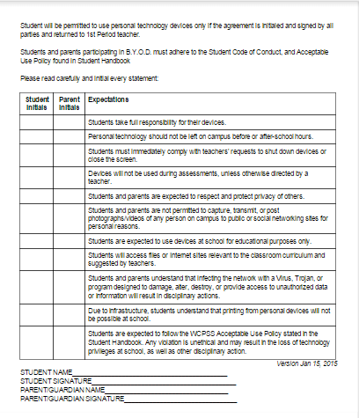

Slide 15
Text Rendering Protocol
Work in groups of 3-4.
Select a facilitator for the group
In groups, individually read the document. Underline a sentence, phrase and word you think is significant.
5 minutes
Notes:
Items needed:
Have paper and pencil for the scribes
AUP copies

Slide 16
Text Rendering Cont.
3 rounds:
  Round 1: Each person shares a sentence from the document that they feel is significant.
  Round 2: Each person shares a phrase that is significant.
  Rounds 3: Each person shares a word they think is significant.
What is this text about?
What questions does the group have?
Notes:
Have the teachers float in the groups to make sure they’re on task.

